Slide 1
Work Progress
By: Abdur Rehman

Slide 2
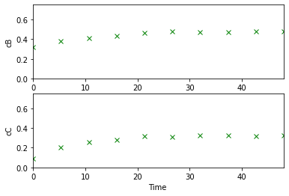
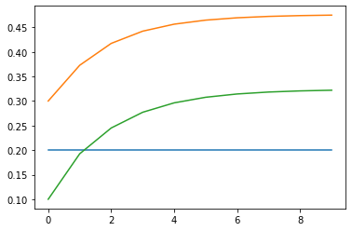
Plant Model: Continuously Stirred Tank Reactor (CSTR)
Seeing the result of how the input - “cAin” impact the result of the simulation
“cAin” = 1
Plant Measurement
Plant State

Slide 3
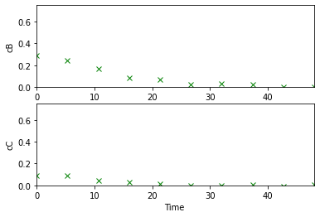
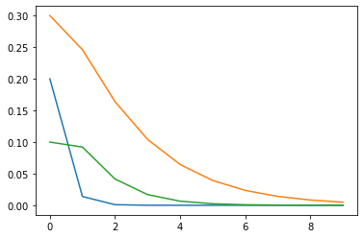
Seeing the result of how the input - “cAin” impact the result of the simulation
“cAin” = 0
Plant Measurement
Plant State

Slide 4
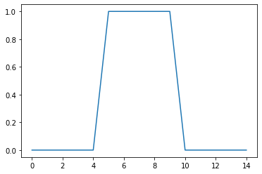
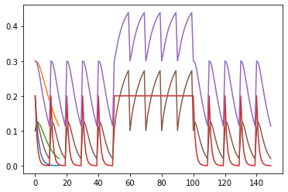
Generation of random STEP Input - “cAin” to see the steady state value
“cAin” = von 0 bis 1 (randomly generated)
cAin
Plant States

Slide 5
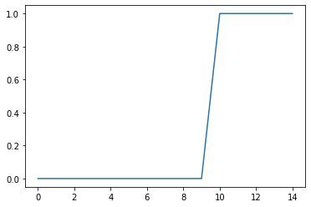
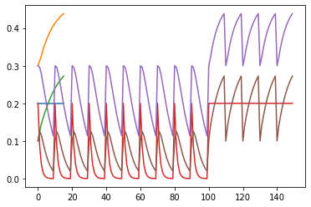
Generation of random STEP Input - “cAin” to see the steady state value
“cAin” = von 0 bis 1 (randomly generated)
cAin
Plant States

Slide 6
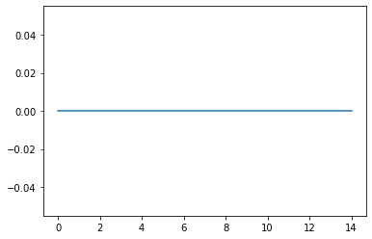
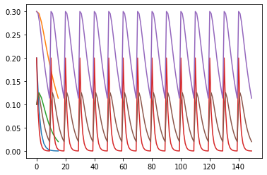
Generation of random STEP Input - “cAin” to see the steady state value
“cAin” = von 0 bis 1 (randomly generated)
cAin
Plant States

Slide 7
Generation of random STEP Input - “cAin” to see the steady state value
“cAin” = von 0 bis 1 (randomly generated)
cAin
Plant States

Slide 8
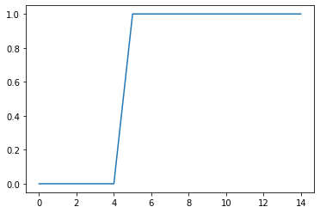
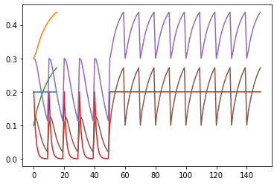
Generation of random STEP Input - “cAin” to see the steady state value
“cAin” = von 0 bis 1 (randomly generated)
cAin
Plant States

